Slide 1
Lec: 16 - SFSS - SP – 03a
Introduction to Illiteracy & Importance of Edu:

Slide 2
Illiteracy

Slide 3
Literacy is traditionally understood as the ability to Read and Write.
("Literate." Merriam-Webster.com. Merriam-Webster, n.d. Web. 19 Aug. 2014. <http://www.merriam-webster.com/dictionary/literate.)

Slide 4
Literate Person
The Person Who Able to
Read Write
Or Understand what He / She is
reading or writing.

Slide 5
Illiterate Person
The Person Who is not Able to
Read Write
Or Understand what He / She is
reading or writing.

Slide 6
International Literacy Day:
September 8 was declared International Literacy Day by UNESCO

Slide 7
Education
Introduction:
Education is the most constructive factor for any society as it opens new horizons / limits for the people to perceive things in different dimensions.
A nation cannot properly understand national aims and goals, if the majority of people remain uneducated.
They cannot understand the value of unity and discipline in life and remain unaware of the latest advancements.
Education improves human, Physical and other resources which further improve the factors of production. So, it is important to set a proper system for education.

Slide 8
Meaning of Education:
Different education theorists have given different derivation of the term education among the important one are,
The word education is derived from the Latin word “ educara” which means “to rare “ to nourish” and “ to bring up”.
Some are the view that education means “to draw out” “to foster” .
One school of thought believes that education is derived from the Latin word “educaturn” which means the act of training. Hence education is “training of child”.
From the close study of the above meaning of education, the key words are,
To bring up, to draw out, to lead out, to nourish, to rear, to teach, and to train.
(D vigaya lakshmi, bashkara roa. Basic education 2004, p.46-47)

Slide 9
Definitions:
In Oxford dictionary it is a “process to give intellectual, moral and social instructions especially as a formal and prolonged process, which may include training or instruction for a particular purpose. It includes development of character mental power through Systematic instruction”
According to Ruskin “Education does not mean teaching people to know what they do not know; it means teaching them to behave, as they do not, for”.
In simple words, it can be defined as “polishing, trimming and civilizing personality”
Plato defined education as “a process of development of physical and mental qualities of human kind.
According to Imam Ghazali, education is “a process which enable an individual to distinguish between true and false the good and bad the right conduct and evil doing.

Slide 10
Importance
&
Power of Education

Slide 11
Education plays the supreme role and has a cross cutting impact on all aspects of human life.
Education is one of the basic necessities of the modern societies, as the society holds its grounds on the basis of education.
It is a dynamic investment for human and economic development.
Gone are the days when nations with most manpower and greatest warriors were considered the best on the surface of earth.
Today the education is the power to rule the world and this is a known fact now.

Slide 12
Developed countries have the highest literacy rate 99%, which is the reason of their ongoing progress. Least developed countries have the lowest literacy rate.
If developing countries want to be at the level of the developed countries, they would have to educate their nation.

Slide 13
Finland
Population 1/4th of Karachi
1 company Nokia
Exports are 2 Times then the GDP of Pakistan.

Slide 14
Austria
Population 1/2 of Karachi
GDP More then the GDP of Pakistan.

Slide 15
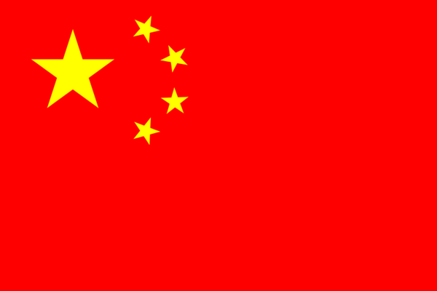
China
Population 1,372,360,000. (30 September, 2015) Source: Official Chinese Population Clock
GDP More then the DGP of Pakistan.

Slide 16
Literacy Ratio in Pakistan

Slide 17
Countries by Literacy Rate:
Country Literacy rate
Russia 99.7
Australia 99
Austria 99
Canada 99
North Korea 100
Finland 99
France 99
Germany 99
United Kingdom 99
United States 99
Italy 99.2
Indonesia 93

Slide 18
Country Literacy rate
China 96.4
Malaysia 94.6
Sri Lanka 90.8
Iran 82.3
Zambia 70.6
India 72
Pakistan 58.7
Bangladesh 61.5
Mali 38.7
Different Sources: (United Nations Educational, Scientific and Cultural Organization (UNESCO), Central Intelligence Agency (CIA) Fact Book,

Slide 19
According to CIA Fact book, 2013, Pakistan ranks 164th among 205 countries.

Slide 20
Literacy Rate in Pakistan
Over-all literacy Rate 58.% | Male Literacy Rate 71.5% | Female Literacy Rate 45.3%
For the year 2013

Slide 21
Pakistan’s literacy rate stands 58 per cent in 2015.
The literacy rate for male during 2015 was 70 percent and for female was 49 percent.

Slide 22
Thanks

